Slide 1
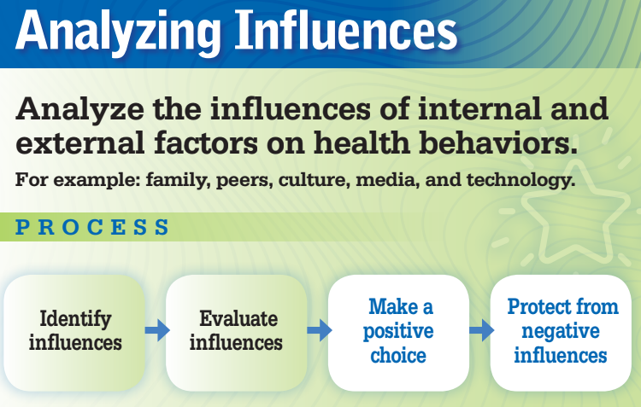
Indicator: 1d.hs2.6 – Identify the influence of power and cultural differences on interpersonal relationships.
Objectives: .
Identify the influence of power and cultural differences on interpersonal relationships.
Agenda
Discuss power and influences on interpersonal relationships
Gallery Walk/Pass the Problem (in small groups)
Class share out & discussion
Homework: Power & Cultural Differences reflection questions
Activator: What kinds of things do you, as a teen, have power over in your life?
Explain why you have control over those things.
Unit: Advocating for Interpersonal Safety
Topic: Discrimination and Violence -Relationships

Slide 2
What kinds of things do you, as a teen, have power over in your life?
Explain why you have control over those things.

Slide 3

Power
The possession of control, authority, or influence over others

Slide 4
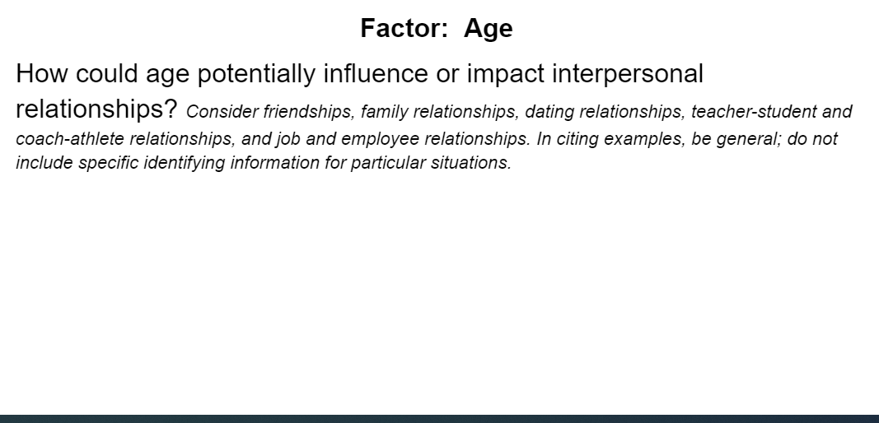
Directions
In your group, discuss and record how the factor could potentially influence various interpersonal relationships.
Move to the next factor responses and add on new examples to the list
Whole group share out
Gallery Walk/Pass the Problem

Slide 5
Period 1 groups
Group 1 | Group 2 | Group 3 | Group 4
Select a different group member for each role:
Writer - has legible handwriting to record on paper
Speaker - shares out to the class
Timekeeper - to keep track of time & keep the group on task
Everyone must partake in the discussion
Group 5 | Group 6 | Group 7 | Group 8

Slide 6
Case study A
Person a and person b have been dating for 3 years. Both partners have sex with other people even though their relationship is not open. Each time one partner cheats, the other person does it too in order to keep things even. Both partners say they will get married eventually and that they love each other. Person a is an undocumented honor student that comes from a large family. Person b is an only child who lives with their grandparents who are wealthy.

Slide 7
Case study B
Leslie is a transgender woman who is dating a cis-gendered man named Eli. They have been dating for 3 months and really like each other. recently an unarmed black person was gravely injured by the police resulting in riots in the streets for weeks. Leslie has been devastated by the recent actions and wants to be active in creating change. Eli thinks it is unsafe to get involved.

Slide 8
Case study C
Mark and Cole met a week ago and have gone out twice in that week. There is interest in each other. Mark has paid both times they have gone out, and money does not seem to be an issue. They went to an expensive restaurant for their first date and then to a concert on their second date. Cole really likes Mark but feels bad that they aren’t able to pay for such expensive dates.

Slide 9
Case study D
Person a started working at the grocery store about four months ago. It’s hard work but person a feels good they are able to help out their family with paying the bills. Person b has been a manager at the grocery store for two years. Person b is attracted to person a and asked them to go out on a date. Person a is unsure whether they want to go on the date.

Slide 10
How could these different factors of power impact a person’s interpersonal relationship?
Age
Race
Ethnicity
Sexual orientation
Gender
Gender
identity
Socioeconomic status
Immigration status
Ability/Capacity- Physical & Mental
Religion

Slide 11
Reflect on one of these prompts...
After today’s lesson, I will now consider….
1 thing I learned today.
1
2
Something I learned today that will influence my relationships is…
3

Slide 12
Relationships are complex. There are so many factors that influence the power dynamics that can impact a relationship. Analyzing these factors, and increasing awareness of potential influences of power and culture on interpersonal relationships, helps us understand the disparities of social wellness..

